Slide 1



Amenities
& Packaging
Concept Product Portfolio
v1.0 / 06 OCTOBER 2026
HOSPITALITY, IN PERFECT PROPORTION
CONCEPT / NOT PRODUCTION ARTWORK
Notes:
GEM Amenities and Packaging Concept Portfolio v1.0. Working edition, concept review only. Source: Part A pp.16, 23–30; Part C pp.3, 28–29. Chat cover composition retained. The fixed tagline is set on one line, correcting the chat line break. Original GEM artwork (supplied vector kit) replaces the proposed typed wordmark.
Authority: V3 Final Brand Approval Register, then domain-owning RC2 Part A/B/C. No production or commercial release is authorized by this portfolio. Logos are the supplied vector kit (SVG), used unchanged; acceptance as production master remains PENDING (VAL-02). All photorealistic images are AI-generated concepts, NOT PRODUCTION PHOTOGRAPHY. Quantity, SKU, formulation, claims, origin, supplier, MOQ, pricing and technical specifications remain pending. Blank structural studies are not finished label artwork.

Slide 2


One master brand
IDENTITY
02
One identity across
physical hospitality.
Amenities & Packaging
Amenities & Packaging is the primary descriptive business stream under GEM. It inherits the master logo, palette, typography and voice.
Hospitality touchpoints
Commercial scope and capability claims remain CONDITIONAL until VAL-01 closes.
DESCRIPTIVE BUSINESS STREAM / CAPABILITIES CONDITIONAL
GEM™ — Amenities & Packaging
v1.0 WORKING EDITION
Notes:
GEM Amenities and Packaging Concept Portfolio v1.0. Working edition, concept review only. Source: Part A pp.12–17; Register T01, AC03, VAL-01. Amenities & Packaging is the approved descriptive stream. Capability evidence remains conditional.
Authority: V3 Final Brand Approval Register, then domain-owning RC2 Part A/B/C. No production or commercial release is authorized by this portfolio. Logos are the supplied vector kit (SVG), used unchanged; acceptance as production master remains PENDING (VAL-02). All photorealistic images are AI-generated concepts, NOT PRODUCTION PHOTOGRAPHY. Quantity, SKU, formulation, claims, origin, supplier, MOQ, pricing and technical specifications remain pending. Blank structural studies are not finished label artwork.

Slide 3

Every arrival
begins with
an object.
HOSPITALITY PHILOSOPHY
03
Precision
Restraint
Geometry
Space
A verified detail.
Nothing without purpose.
A shared visual language.
Room to notice.
CONCEPT / NOT PRODUCTION PHOTOGRAPHY
GEM™ — Amenities & Packaging
v1.0 WORKING EDITION
Notes:
GEM Amenities and Packaging Concept Portfolio v1.0. Working edition, concept review only. Source: Part A pp.6–11, 47; chat slide 03. Editorial phrase from the chat is concept copy, not a replacement tagline.
Authority: V3 Final Brand Approval Register, then domain-owning RC2 Part A/B/C. No production or commercial release is authorized by this portfolio. Logos are the supplied vector kit (SVG), used unchanged; acceptance as production master remains PENDING (VAL-02). All photorealistic images are AI-generated concepts, NOT PRODUCTION PHOTOGRAPHY. Quantity, SKU, formulation, claims, origin, supplier, MOQ, pricing and technical specifications remain pending. Blank structural studies are not finished label artwork.

Slide 4


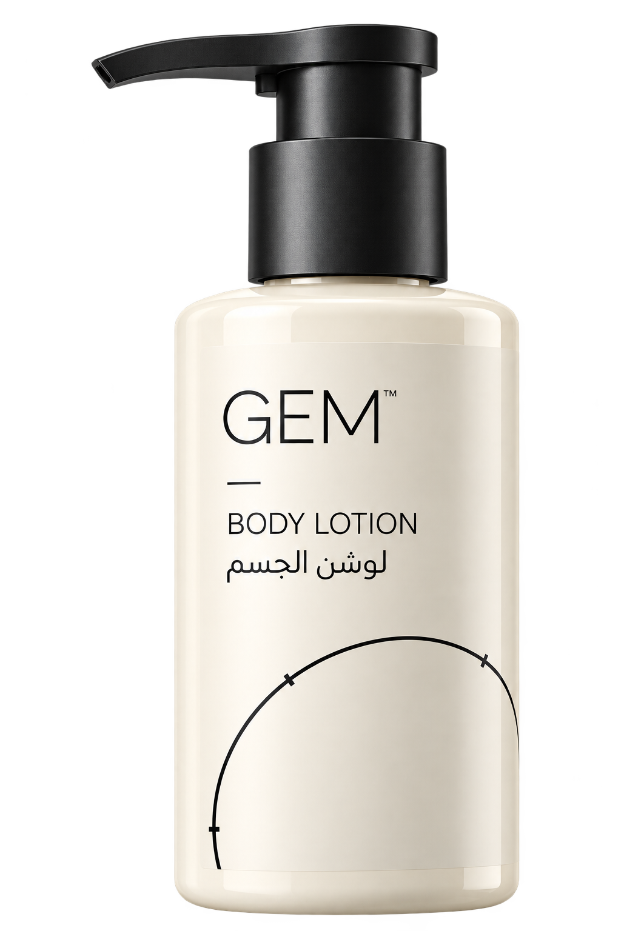

One system. Many touchpoints.
PILOT COLLECTION
04
PILOT COLLECTION / CONCEPT / NOT PRODUCTION ARTWORK
GEM™ — Amenities & Packaging
v1.0 WORKING EDITION
Notes:
GEM Amenities and Packaging Concept Portfolio v1.0. Working edition, concept review only. Source: Part C pp.28–29; Part A pp.61–62; chat slide 04. Identical generated body and cap are intentionally reused to hold family geometry constant. Physical dimensions are not specified.
Authority: V3 Final Brand Approval Register, then domain-owning RC2 Part A/B/C. No production or commercial release is authorized by this portfolio. Logos are the supplied vector kit (SVG), used unchanged; acceptance as production master remains PENDING (VAL-02). All photorealistic images are AI-generated concepts, NOT PRODUCTION PHOTOGRAPHY. Quantity, SKU, formulation, claims, origin, supplier, MOQ, pricing and technical specifications remain pending. Blank structural studies are not finished label artwork.

Slide 5

Shampoo
PILOT COLLECTION
05
Shared cap and shoulder
[COLLECTION / TIER PENDING]
Shampoo
[FUNCTION PENDING]
[QUANTITY / SIZE PENDING]
[INSTRUCTIONS / MARKET INFORMATION PENDING]
[SKU / ARTWORK VERSION PENDING]
The first object establishes the proportions of the family.
CONCEPT / NOT PRODUCTION ARTWORK / PRODUCT DATA PENDING
GEM™ — Amenities & Packaging
v1.0 WORKING EDITION
Notes:
GEM Amenities and Packaging Concept Portfolio v1.0. Working edition, concept review only. Source: Part C pp.28–35; Part A pp.61–62; chat product direction. The enlarged label is editable and carries all six approved hierarchy levels. Environmental image is a blank form study.
Authority: V3 Final Brand Approval Register, then domain-owning RC2 Part A/B/C. No production or commercial release is authorized by this portfolio. Logos are the supplied vector kit (SVG), used unchanged; acceptance as production master remains PENDING (VAL-02). All photorealistic images are AI-generated concepts, NOT PRODUCTION PHOTOGRAPHY. Quantity, SKU, formulation, claims, origin, supplier, MOQ, pricing and technical specifications remain pending. Blank structural studies are not finished label artwork.

Slide 6

Conditioner
PILOT COLLECTION
06
Shared cap and shoulder
[COLLECTION / TIER PENDING]
Conditioner
[FUNCTION PENDING]
[QUANTITY / SIZE PENDING]
[INSTRUCTIONS / MARKET INFORMATION PENDING]
[SKU / ARTWORK VERSION PENDING]
The product name changes. The packaging language holds.
CONCEPT / NOT PRODUCTION ARTWORK / PRODUCT DATA PENDING
GEM™ — Amenities & Packaging
v1.0 WORKING EDITION
Notes:
GEM Amenities and Packaging Concept Portfolio v1.0. Working edition, concept review only. Source: Part C pp.28–35; Part A pp.61–62; chat product direction. The enlarged label is editable and carries all six approved hierarchy levels. Environmental image is a blank form study.
Authority: V3 Final Brand Approval Register, then domain-owning RC2 Part A/B/C. No production or commercial release is authorized by this portfolio. Logos are the supplied vector kit (SVG), used unchanged; acceptance as production master remains PENDING (VAL-02). All photorealistic images are AI-generated concepts, NOT PRODUCTION PHOTOGRAPHY. Quantity, SKU, formulation, claims, origin, supplier, MOQ, pricing and technical specifications remain pending. Blank structural studies are not finished label artwork.

Slide 7
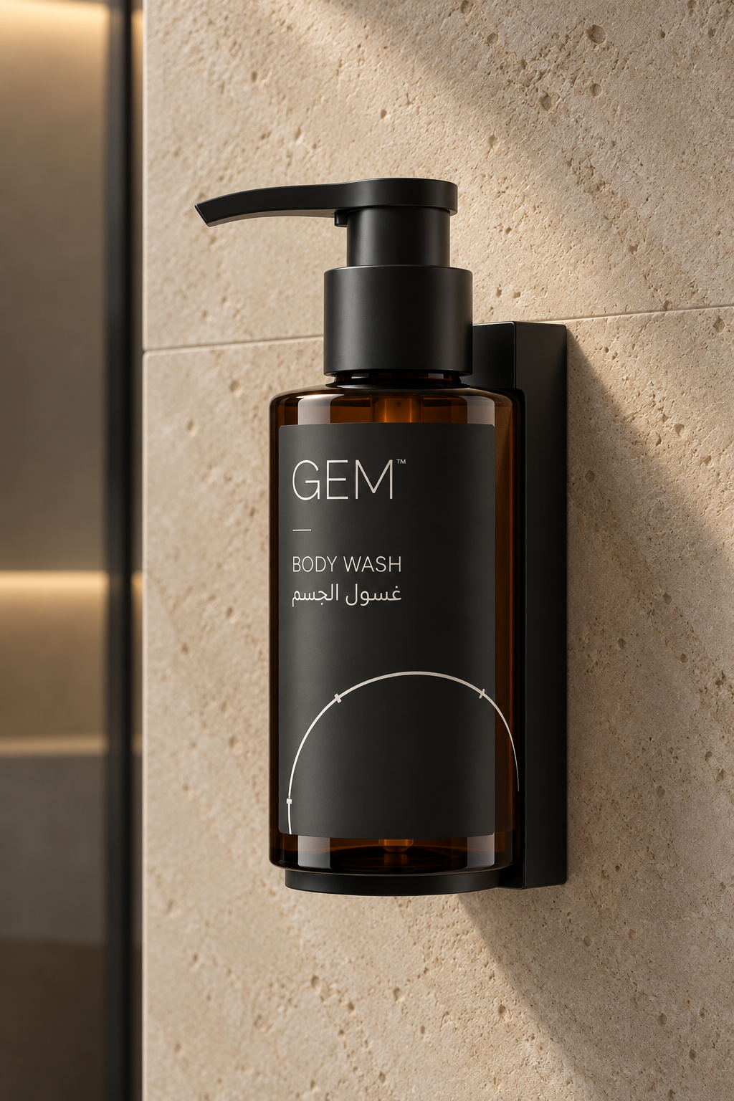
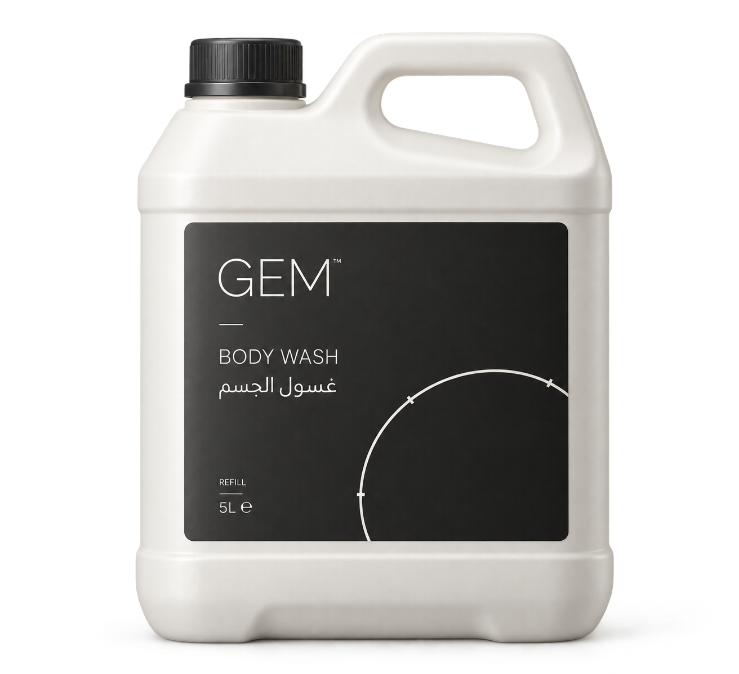
Body Wash
DISPENSING FORMATS
07
Guest bottle
Wall-mounted concept
Refill concept
CONCEPT
SUPPLIER PROOF REQUIRED
SUPPLIER PROOF REQUIRED
CONCEPT / NOT PRODUCTION ARTWORK / FORMAT AND COMPATIBILITY PENDING
GEM™ — Amenities & Packaging
v1.0 WORKING EDITION
Notes:
GEM Amenities and Packaging Concept Portfolio v1.0. Working edition, concept review only. Source: Part C pp.28, 32, 36; chat slide 07. Wall-mounted and refill formats are structural concepts only. Compatibility, hygiene, maintenance and mounting require supplier review.
Authority: V3 Final Brand Approval Register, then domain-owning RC2 Part A/B/C. No production or commercial release is authorized by this portfolio. Logos are the supplied vector kit (SVG), used unchanged; acceptance as production master remains PENDING (VAL-02). All photorealistic images are AI-generated concepts, NOT PRODUCTION PHOTOGRAPHY. Quantity, SKU, formulation, claims, origin, supplier, MOQ, pricing and technical specifications remain pending. Blank structural studies are not finished label artwork.

Slide 8
Body Lotion
PILOT COLLECTION
08
A consistent place
in the family.
The same body, closure direction and information order support recognition across the pilot.
Formula and dispensing compatibility
[PENDING] Supplier testing and product-owner review.
CONCEPT / NOT PRODUCTION ARTWORK / PRODUCT DATA PENDING
GEM™ — Amenities & Packaging
v1.0 WORKING EDITION
Notes:
GEM Amenities and Packaging Concept Portfolio v1.0. Working edition, concept review only. Source: Part C pp.28–29, 32–36. Source-defined product. Visual bottle proposal carries no formulation, benefit, fragrance or ingredient claim.
Authority: V3 Final Brand Approval Register, then domain-owning RC2 Part A/B/C. No production or commercial release is authorized by this portfolio. Logos are the supplied vector kit (SVG), used unchanged; acceptance as production master remains PENDING (VAL-02). All photorealistic images are AI-generated concepts, NOT PRODUCTION PHOTOGRAPHY. Quantity, SKU, formulation, claims, origin, supplier, MOQ, pricing and technical specifications remain pending. Blank structural studies are not finished label artwork.

Slide 9
Hand Wash
PILOT COLLECTION
09
One family,
throughout
the stay.
Product names carry the distinction.
The master identity stays constant.
CONCEPT / NOT PRODUCTION ARTWORK / DISPENSING FORMAT PENDING
GEM™ — Amenities & Packaging
v1.0 WORKING EDITION
Notes:
GEM Amenities and Packaging Concept Portfolio v1.0. Working edition, concept review only. Source: Part C pp.28–29, 32–36. A shared-cap guest-bottle concept. Dispensing format remains supplier-dependent and no efficacy claim is made.
Authority: V3 Final Brand Approval Register, then domain-owning RC2 Part A/B/C. No production or commercial release is authorized by this portfolio. Logos are the supplied vector kit (SVG), used unchanged; acceptance as production master remains PENDING (VAL-02). All photorealistic images are AI-generated concepts, NOT PRODUCTION PHOTOGRAPHY. Quantity, SKU, formulation, claims, origin, supplier, MOQ, pricing and technical specifications remain pending. Blank structural studies are not finished label artwork.

Slide 10
Packaging DNA
PACKAGING ARCHITECTURE
10
Shared silhouette
Bottle and closure remain supplier-dependent.
Original GEM artwork
Supplied vector kit; production master acceptance pending.
Fixed hierarchy
Six levels, in the register’s approved order.
CONCEPT / NOT PRODUCTION ARTWORK / NO DIMENSIONAL SPECIFICATION
GEM™ — Amenities & Packaging
v1.0 WORKING EDITION
Notes:
GEM Amenities and Packaging Concept Portfolio v1.0. Working edition, concept review only. Source: Part A pp.29, 40–44, 61; Part C pp.10, 20, 29, 32. Editable annotations describe the visual concept. No physical safe-area or dimensional value is asserted.
Authority: V3 Final Brand Approval Register, then domain-owning RC2 Part A/B/C. No production or commercial release is authorized by this portfolio. Logos are the supplied vector kit (SVG), used unchanged; acceptance as production master remains PENDING (VAL-02). All photorealistic images are AI-generated concepts, NOT PRODUCTION PHOTOGRAPHY. Quantity, SKU, formulation, claims, origin, supplier, MOQ, pricing and technical specifications remain pending. Blank structural studies are not finished label artwork.

Slide 11
Three tiers, one identity
PACKAGING ARCHITECTURE
11
01
02
03
Core Collection
Property Edition
Bespoke Programme
Name [REQUIRES OWNER]
Scope [PENDING]
Property adaptation
Scope [PENDING]
Partner programme
Scope [PENDING]
CONDITIONAL
CONDITIONAL
CONDITIONAL
ALL TIERS: AC03 / VAL-01 / NO NEW LOGO, PALETTE OR SUB-BRAND
GEM™ — Amenities & Packaging
v1.0 WORKING EDITION
Notes:
GEM Amenities and Packaging Concept Portfolio v1.0. Working edition, concept review only. Source: Part A p.60; Part C p.27; Register E14, AC03, VAL-01. Core Collection name requires owner approval. Property Edition and Bespoke Programme scope remains conditional.
Authority: V3 Final Brand Approval Register, then domain-owning RC2 Part A/B/C. No production or commercial release is authorized by this portfolio. Logos are the supplied vector kit (SVG), used unchanged; acceptance as production master remains PENDING (VAL-02). All photorealistic images are AI-generated concepts, NOT PRODUCTION PHOTOGRAPHY. Quantity, SKU, formulation, claims, origin, supplier, MOQ, pricing and technical specifications remain pending. Blank structural studies are not finished label artwork.

Slide 12
Property Edition
PACKAGING ARCHITECTURE
12
A property layer
within the GEM system.
[PROPERTY NAME]
Property information follows the agreed relationship. GEM retains its own artwork and clearspace. Each partner’s mark remains independent.
[RELATIONSHIP PENDING]
Partner artwork and precedence: [REQUIRES OWNER]
CONDITIONAL / CONCEPT / NOT PRODUCTION ARTWORK
GEM™ — Amenities & Packaging
v1.0 WORKING EDITION
Notes:
GEM Amenities and Packaging Concept Portfolio v1.0. Working edition, concept review only. Source: Part A pp.31, 60; Part C p.27; Register E14. Illustrative property relationship only. No real property, partner or commercial agreement is implied.
Authority: V3 Final Brand Approval Register, then domain-owning RC2 Part A/B/C. No production or commercial release is authorized by this portfolio. Logos are the supplied vector kit (SVG), used unchanged; acceptance as production master remains PENDING (VAL-02). All photorealistic images are AI-generated concepts, NOT PRODUCTION PHOTOGRAPHY. Quantity, SKU, formulation, claims, origin, supplier, MOQ, pricing and technical specifications remain pending. Blank structural studies are not finished label artwork.

Slide 13
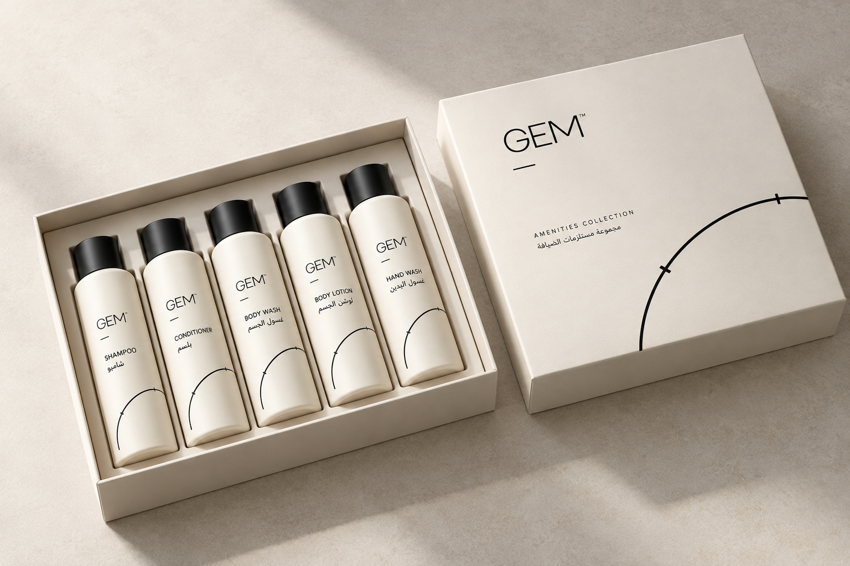
Bespoke Programme
PACKAGING ARCHITECTURE
13
A considered
unboxing.
The identity remains fixed.
Structure is developed against
a confirmed brief.
CONDITIONAL / STRUCTURAL CONCEPT / SUPPLIER PROOF REQUIRED
GEM™ — Amenities & Packaging
v1.0 WORKING EDITION
Notes:
GEM Amenities and Packaging Concept Portfolio v1.0. Working edition, concept review only. Source: Part A p.60; Part C pp.27, 31–32, 36. Open-box image is an unprinted structural study. Insert, closure, dimensions and commercial scope remain pending.
Authority: V3 Final Brand Approval Register, then domain-owning RC2 Part A/B/C. No production or commercial release is authorized by this portfolio. Logos are the supplied vector kit (SVG), used unchanged; acceptance as production master remains PENDING (VAL-02). All photorealistic images are AI-generated concepts, NOT PRODUCTION PHOTOGRAPHY. Quantity, SKU, formulation, claims, origin, supplier, MOQ, pricing and technical specifications remain pending. Blank structural studies are not finished label artwork.

Slide 14
Six levels of information
LABEL ARCHITECTURE
14
01
GEM master artwork
Localization space
02
Collection / tier
Arabic copy [PENDING]
Native RTL composition.
No letterspacing.
Logo orientation unchanged.
Technical identifiers remain LTR.
03
Product / function
04
Quantity / size
05
Instructions / market information
06
SKU / artwork version
PENDING LOCALIZATION APPROVAL
CONCEPT / NOT PRODUCTION ARTWORK / LABEL DATA REMAINS PENDING
GEM™ — Amenities & Packaging
v1.0 WORKING EDITION
Notes:
GEM Amenities and Packaging Concept Portfolio v1.0. Working edition, concept review only. Source: Part A pp.37–39, 61; Part C pp.17, 29–35; Register T05. Corrects the chat’s eight-step hierarchy. Collection/tier is retained. Concept status is a document annotation, not a seventh product-information level. Arabic copy is not invented.
Authority: V3 Final Brand Approval Register, then domain-owning RC2 Part A/B/C. No production or commercial release is authorized by this portfolio. Logos are the supplied vector kit (SVG), used unchanged; acceptance as production master remains PENDING (VAL-02). All photorealistic images are AI-generated concepts, NOT PRODUCTION PHOTOGRAPHY. Quantity, SKU, formulation, claims, origin, supplier, MOQ, pricing and technical specifications remain pending. Blank structural studies are not finished label artwork.

Slide 15
Structure follows the supplier brief
STRUCTURAL FRAMEWORK
15
Primary pack
Secondary pack
Physical proof
Format, resin and closure
[REQUIRES SUPPLIER]
Carton, insert and dieline
[REQUIRES SUPPLIER]
Fit, durability and compatibility
[PENDING PHYSICAL PROOF]
Bleed, safe area and tolerances come from the supplier dieline, once supplied and approved.
STRUCTURAL CONCEPT / SUPPLIER PROOF REQUIRED
GEM™ — Amenities & Packaging
v1.0 WORKING EDITION
Notes:
GEM Amenities and Packaging Concept Portfolio v1.0. Working edition, concept review only. Source: Part C pp.20, 30–36. No supplier dieline has been supplied. The framework depicts dependencies, not manufacturing geometry.
Authority: V3 Final Brand Approval Register, then domain-owning RC2 Part A/B/C. No production or commercial release is authorized by this portfolio. Logos are the supplied vector kit (SVG), used unchanged; acceptance as production master remains PENDING (VAL-02). All photorealistic images are AI-generated concepts, NOT PRODUCTION PHOTOGRAPHY. Quantity, SKU, formulation, claims, origin, supplier, MOQ, pricing and technical specifications remain pending. Blank structural studies are not finished label artwork.

Slide 16

Material direction
MATERIALS
16
Warm uncoated stock
Ink board
Matte surfaces
Material specification
[REQUIRES SUPPLIER / OWNER]
CONCEPT / NOT PRODUCTION PHOTOGRAPHY / PENDING PHYSICAL PROOF
GEM™ — Amenities & Packaging
v1.0 WORKING EDITION
Notes:
GEM Amenities and Packaging Concept Portfolio v1.0. Working edition, concept review only. Source: Part A p.63; Part C pp.22–25, 32. Images show visual texture only. No resin, stock grade, GSM, recycled content, coating or manufacturer is specified.
Authority: V3 Final Brand Approval Register, then domain-owning RC2 Part A/B/C. No production or commercial release is authorized by this portfolio. Logos are the supplied vector kit (SVG), used unchanged; acceptance as production master remains PENDING (VAL-02). All photorealistic images are AI-generated concepts, NOT PRODUCTION PHOTOGRAPHY. Quantity, SKU, formulation, claims, origin, supplier, MOQ, pricing and technical specifications remain pending. Blank structural studies are not finished label artwork.

Slide 17

Finish direction
MATERIALS
17
Deboss
Blind emboss
Soft-touch
Precision die-cut
Depth, pressure and registration
[TO BE VERIFIED BY PROCESS TEST]
CONCEPT / NOT PRODUCTION PHOTOGRAPHY / PENDING PHYSICAL PROOF
GEM™ — Amenities & Packaging
v1.0 WORKING EDITION
Notes:
GEM Amenities and Packaging Concept Portfolio v1.0. Working edition, concept review only. Source: Part A p.63; Part C pp.24–25. Finish directions require process trials. Macro image is illustrative, not a tooling specification or approved logo reproduction.
Authority: V3 Final Brand Approval Register, then domain-owning RC2 Part A/B/C. No production or commercial release is authorized by this portfolio. Logos are the supplied vector kit (SVG), used unchanged; acceptance as production master remains PENDING (VAL-02). All photorealistic images are AI-generated concepts, NOT PRODUCTION PHOTOGRAPHY. Quantity, SKU, formulation, claims, origin, supplier, MOQ, pricing and technical specifications remain pending. Blank structural studies are not finished label artwork.

Slide 18
One hospitality ecosystem
GUEST EXPERIENCE
18
01
02
03
04
05
06
Arrival
Stay
Dining
Service
Departure
Return
Key card
Welcome
Amenities
Room card
Menu
Reservation
Request
Recovery
Folio
Farewell
Follow-up
Invitation
CONCEPT / NOT PRODUCTION ARTWORK / TOUCHPOINT SCOPE CONDITIONAL
GEM™ — Amenities & Packaging
v1.0 WORKING EDITION
Notes:
GEM Amenities and Packaging Concept Portfolio v1.0. Working edition, concept review only. Source: Part A pp.55–58. Touchpoints illustrate identity continuity. They do not expand or validate GEM’s commercial service scope.
Authority: V3 Final Brand Approval Register, then domain-owning RC2 Part A/B/C. No production or commercial release is authorized by this portfolio. Logos are the supplied vector kit (SVG), used unchanged; acceptance as production master remains PENDING (VAL-02). All photorealistic images are AI-generated concepts, NOT PRODUCTION PHOTOGRAPHY. Quantity, SKU, formulation, claims, origin, supplier, MOQ, pricing and technical specifications remain pending. Blank structural studies are not finished label artwork.

Slide 19
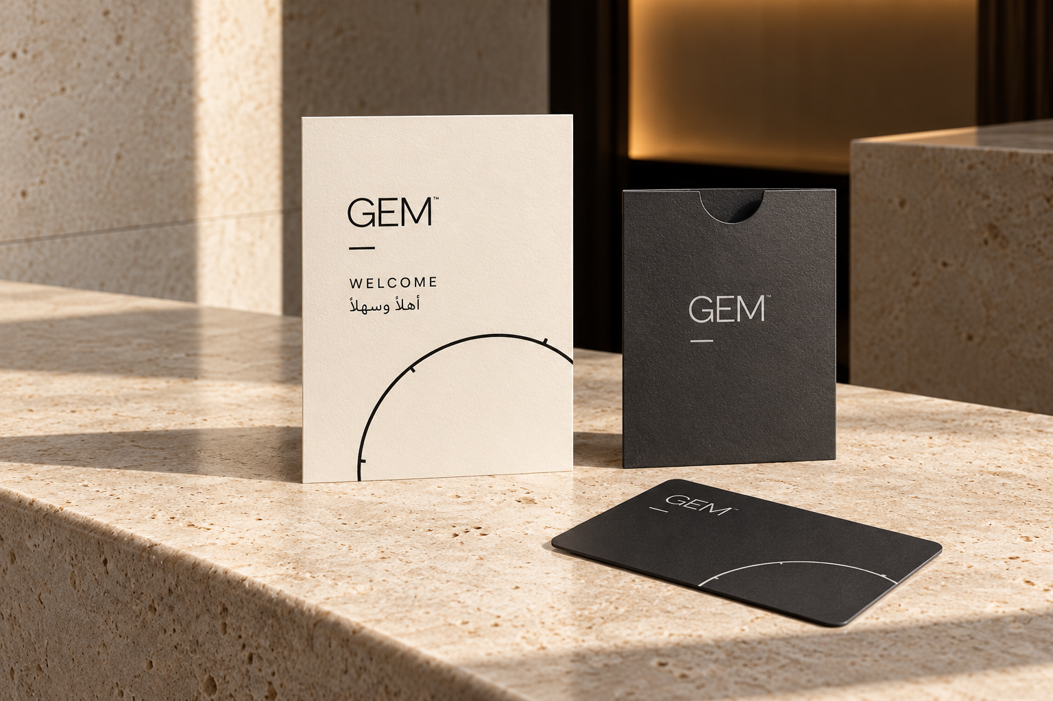
Arrival, precisely composed
GUEST EXPERIENCE
19
A welcome card.
A key sleeve.
Space between.
One identity gives each
object its place.
CONCEPT / NOT PRODUCTION PHOTOGRAPHY / COPY AND PRODUCTION DATA PENDING
GEM™ — Amenities & Packaging
v1.0 WORKING EDITION
Notes:
GEM Amenities and Packaging Concept Portfolio v1.0. Working edition, concept review only. Source: Part A pp.55–56; Part C pp.23, 44. Welcome-card, sleeve and key-card are unprinted form studies. Final copy, dimensions and property information require approval.
Authority: V3 Final Brand Approval Register, then domain-owning RC2 Part A/B/C. No production or commercial release is authorized by this portfolio. Logos are the supplied vector kit (SVG), used unchanged; acceptance as production master remains PENDING (VAL-02). All photorealistic images are AI-generated concepts, NOT PRODUCTION PHOTOGRAPHY. Quantity, SKU, formulation, claims, origin, supplier, MOQ, pricing and technical specifications remain pending. Blank structural studies are not finished label artwork.

Slide 20
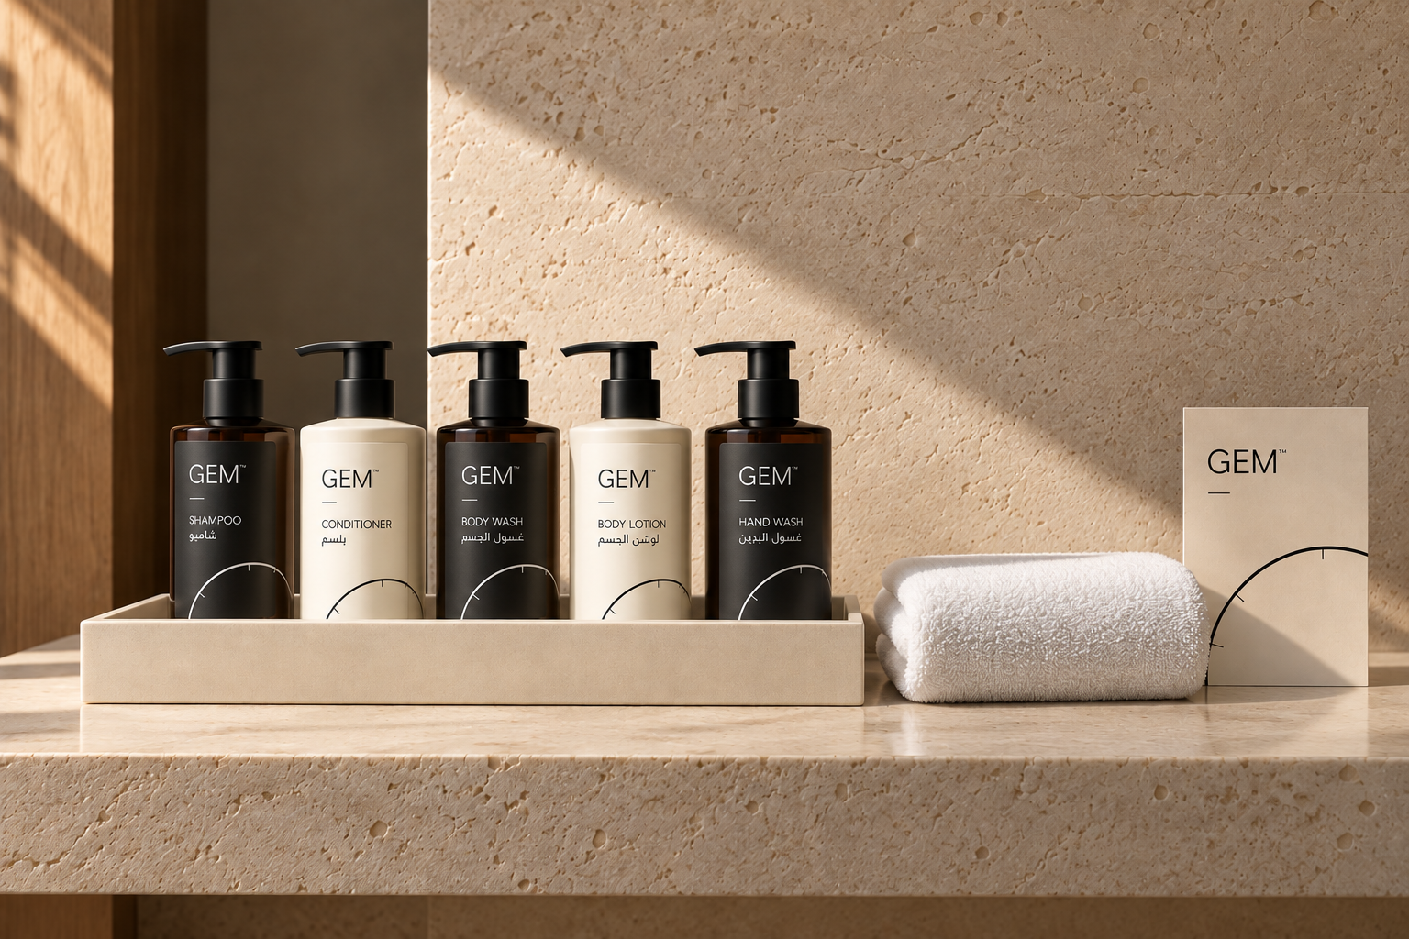
The room as a composed set
GUEST EXPERIENCE
20
The objects share
a visual rhythm.
Placement and replenishment
remain property-specific.
[REQUIRES OWNER]
CONCEPT / NOT PRODUCTION PHOTOGRAPHY / OPERATIONAL VALIDATION PENDING
GEM™ — Amenities & Packaging
v1.0 WORKING EDITION
Notes:
GEM Amenities and Packaging Concept Portfolio v1.0. Working edition, concept review only. Source: Part A pp.55, 57, 62; Part C pp.28, 32, 36. Tray and room arrangement are editorial proposals. Dimensions, cleaning, durability and product compatibility require supplier and operations validation.
Authority: V3 Final Brand Approval Register, then domain-owning RC2 Part A/B/C. No production or commercial release is authorized by this portfolio. Logos are the supplied vector kit (SVG), used unchanged; acceptance as production master remains PENDING (VAL-02). All photorealistic images are AI-generated concepts, NOT PRODUCTION PHOTOGRAPHY. Quantity, SKU, formulation, claims, origin, supplier, MOQ, pricing and technical specifications remain pending. Blank structural studies are not finished label artwork.

Slide 21
Production release sequence
PRODUCTION
21
01
02
03
04
05
06
07
Brief received
Correct master
identified
Technical spec
confirmed
Supplier template
or dieline
Artwork
prepared
Internal
preflight
Supplier
proof
08
09
10
11
12
13
14
Brand review
Technical and
regulatory review
Physical proof
or sample
Corrections
Final approval
Production
release
Job record
archived
Step 11 corrections return to step 5. No step is bypassed without written approval.
GEM™ — Amenities & Packaging
v1.0 WORKING EDITION
Notes:
GEM Amenities and Packaging Concept Portfolio v1.0. Working edition, concept review only. Source: Part C p.5. All fourteen source steps retained. Corrections at step 11 return to step 5. This is a workflow diagram, not evidence of approvals.
Authority: V3 Final Brand Approval Register, then domain-owning RC2 Part A/B/C. No production or commercial release is authorized by this portfolio. Logos are the supplied vector kit (SVG), used unchanged; acceptance as production master remains PENDING (VAL-02). All photorealistic images are AI-generated concepts, NOT PRODUCTION PHOTOGRAPHY. Quantity, SKU, formulation, claims, origin, supplier, MOQ, pricing and technical specifications remain pending. Blank structural studies are not finished label artwork.

Slide 22
Six gates before release
GOVERNANCE
22
01
Master assets
02
Production specification
VAL-02 / 03 / 04 / OPEN
AC17 / VAL-05 / 10 / OPEN
03
Supplier proof
04
Physical validation
VAL-09 / 11 / OPEN
VAL-09 / 15; VAL-12 deferred / OPEN
05
Governance
06
Release authorization
AC19 / VAL-16 / 21 / OPEN
AC20 / OPEN
WORKING EDITION / PENDING PRODUCTION VALIDATION
GEM™ — Amenities & Packaging
v1.0 WORKING EDITION
Notes:
GEM Amenities and Packaging Concept Portfolio v1.0. Working edition, concept review only. Source: Part C pp.75–76; Register AC19, AC20, VAL-01–21. All six release gates are open in the governing RC2 sources. This portfolio does not close them.
Authority: V3 Final Brand Approval Register, then domain-owning RC2 Part A/B/C. No production or commercial release is authorized by this portfolio. Logos are the supplied vector kit (SVG), used unchanged; acceptance as production master remains PENDING (VAL-02). All photorealistic images are AI-generated concepts, NOT PRODUCTION PHOTOGRAPHY. Quantity, SKU, formulation, claims, origin, supplier, MOQ, pricing and technical specifications remain pending. Blank structural studies are not finished label artwork.

Slide 23
Concept and asset control
SUPPORTING REGISTERS
23
REGISTER | CONTROLS | CURRENT STATE
Concept register | Scope, source and validation dependency | CONCEPT
Asset register | Origin, use, rights and file checksum | PENDING VALIDATION
Source / change log | RC2 rules and departures from chat | WORKING EDITION
Open decisions | Accountable role and closure evidence | [REQUIRES OWNER]
No item in this portfolio is an approved production asset.
REVIEW PACKAGE / OWNER APPROVAL AND PRODUCTION RELEASE REMAIN OPEN
GEM™ — Amenities & Packaging
v1.0 WORKING EDITION
Notes:
GEM Amenities and Packaging Concept Portfolio v1.0. Working edition, concept review only. Source: Part C pp.30, 73–74; Register AC19, AC20. A mockup register is provided with this package; other registers are not part of it. IDs are internal portfolio references, not SKUs or approved master IDs.
Authority: V3 Final Brand Approval Register, then domain-owning RC2 Part A/B/C. No production or commercial release is authorized by this portfolio. Logos are the supplied vector kit (SVG), used unchanged; acceptance as production master remains PENDING (VAL-02). All photorealistic images are AI-generated concepts, NOT PRODUCTION PHOTOGRAPHY. Quantity, SKU, formulation, claims, origin, supplier, MOQ, pricing and technical specifications remain pending. Blank structural studies are not finished label artwork.

Slide 24
Every arrival,
precisely composed.
Amenities & Packaging
Concept Product Portfolio v1.0
WORKING EDITION / CONCEPT / NOT PRODUCTION ARTWORK
Notes:
GEM Amenities and Packaging Concept Portfolio v1.0. Working edition, concept review only. Source: Part A pp.23–24; Part C pp.75–78. Secondary line appears alone at headline weight. No approval or capability claim is implied.
Authority: V3 Final Brand Approval Register, then domain-owning RC2 Part A/B/C. No production or commercial release is authorized by this portfolio. Logos are the supplied vector kit (SVG), used unchanged; acceptance as production master remains PENDING (VAL-02). All photorealistic images are AI-generated concepts, NOT PRODUCTION PHOTOGRAPHY. Quantity, SKU, formulation, claims, origin, supplier, MOQ, pricing and technical specifications remain pending. Blank structural studies are not finished label artwork.

